Slide 1

Bitcoin: System Architecture, Opportunities and Challenges
Sascha Boehme
saschafb@gmail.com
March 9, 2015

Slide 2
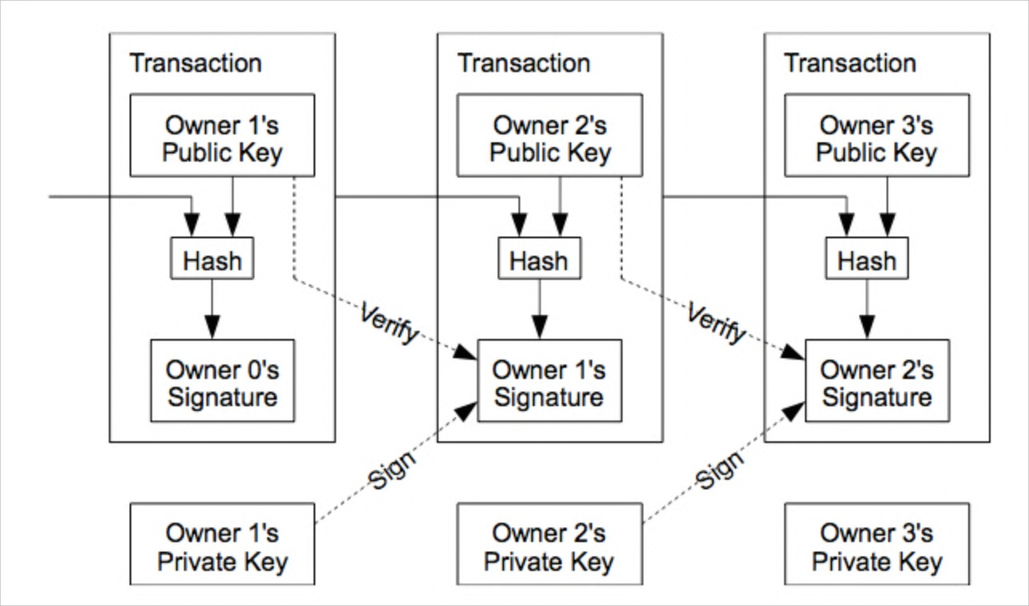
“The only way to confirm the absence of a transaction is to be aware of all transactions.”
Source: S. Nakamoto, “Bitcoin: A peer-to-peer electronic cash system,” 2008.

Slide 3
Content
What is Bitcoin?
System Architecture
Opportunities
Challenges
Closing
Q&A

Slide 4
What is Bitcoin?
System Architecture
Opportunities
Challenges
Closing
Q&A

Slide 5
Bitcoin is a Cryptocurrency
What is Bitcoin?
Source: Royal Canadian Mint

Slide 6
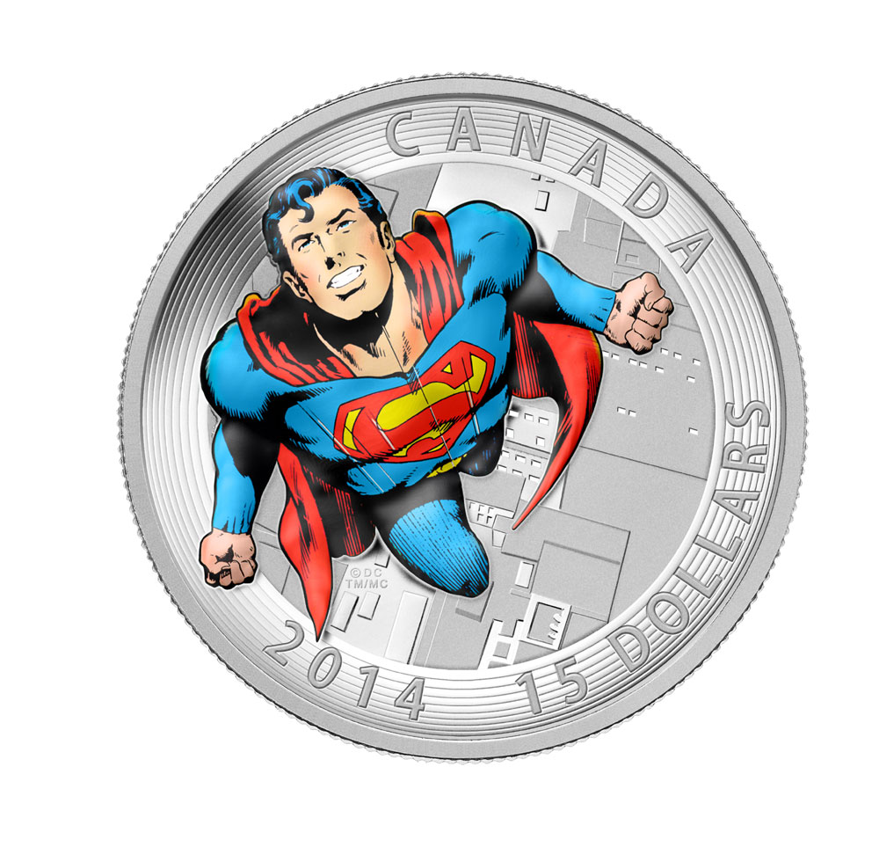
Bitcoin is a Cryptocurrency
What is Bitcoin?
Bitcoin is money and a peer-to-peer payment network
Sources: Royal Canadian Mint, bitcoin.org

Slide 7
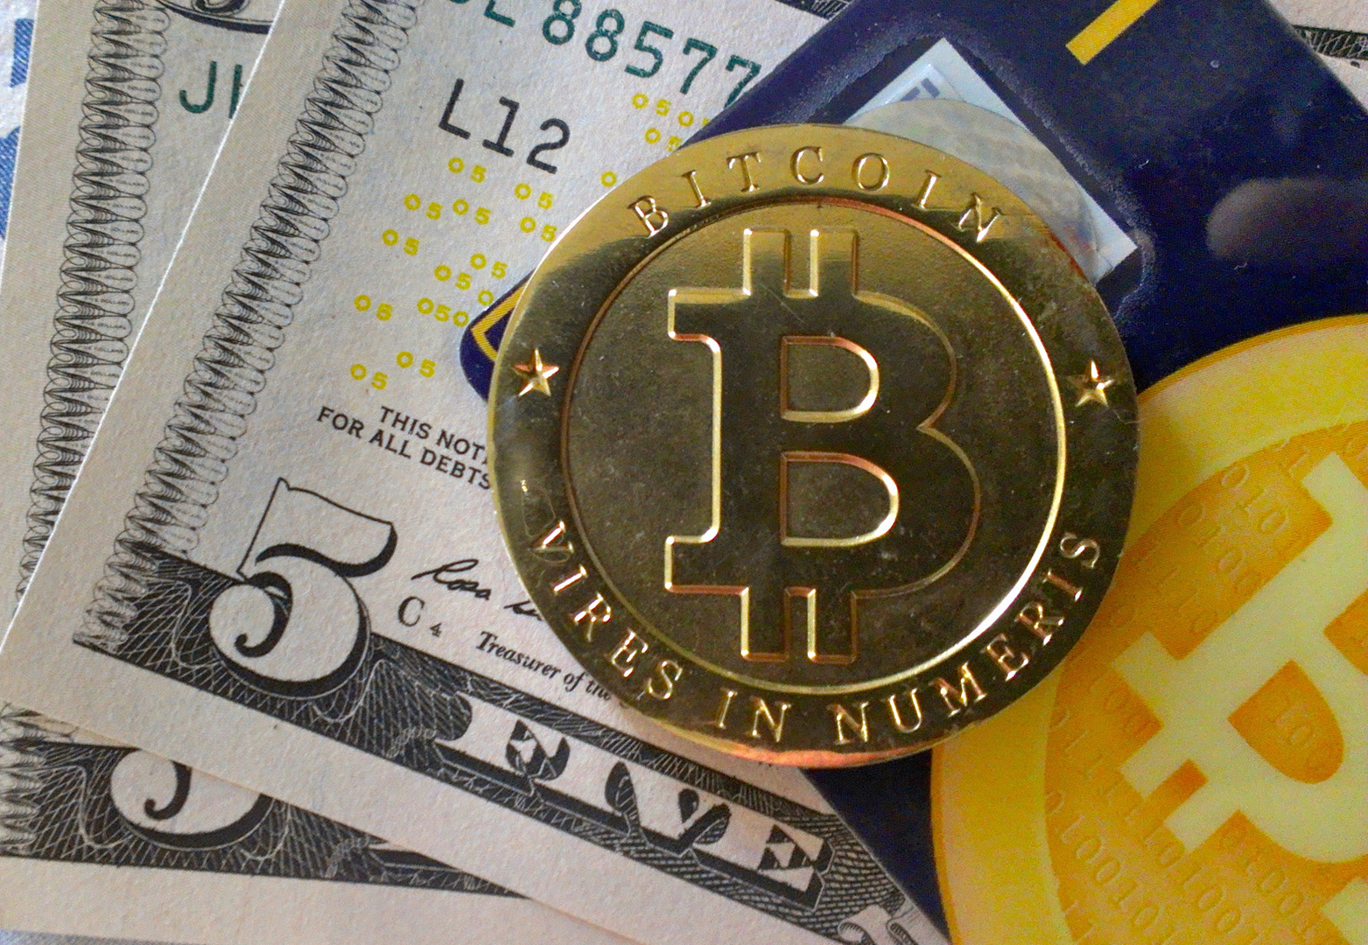
Money is a …
What is Bitcoin?
medium of exchange something that people can use to buy and sell from one another;
unit of account providing a common basis for prices;
store of value which means people can save it and use it later.

Slide 8
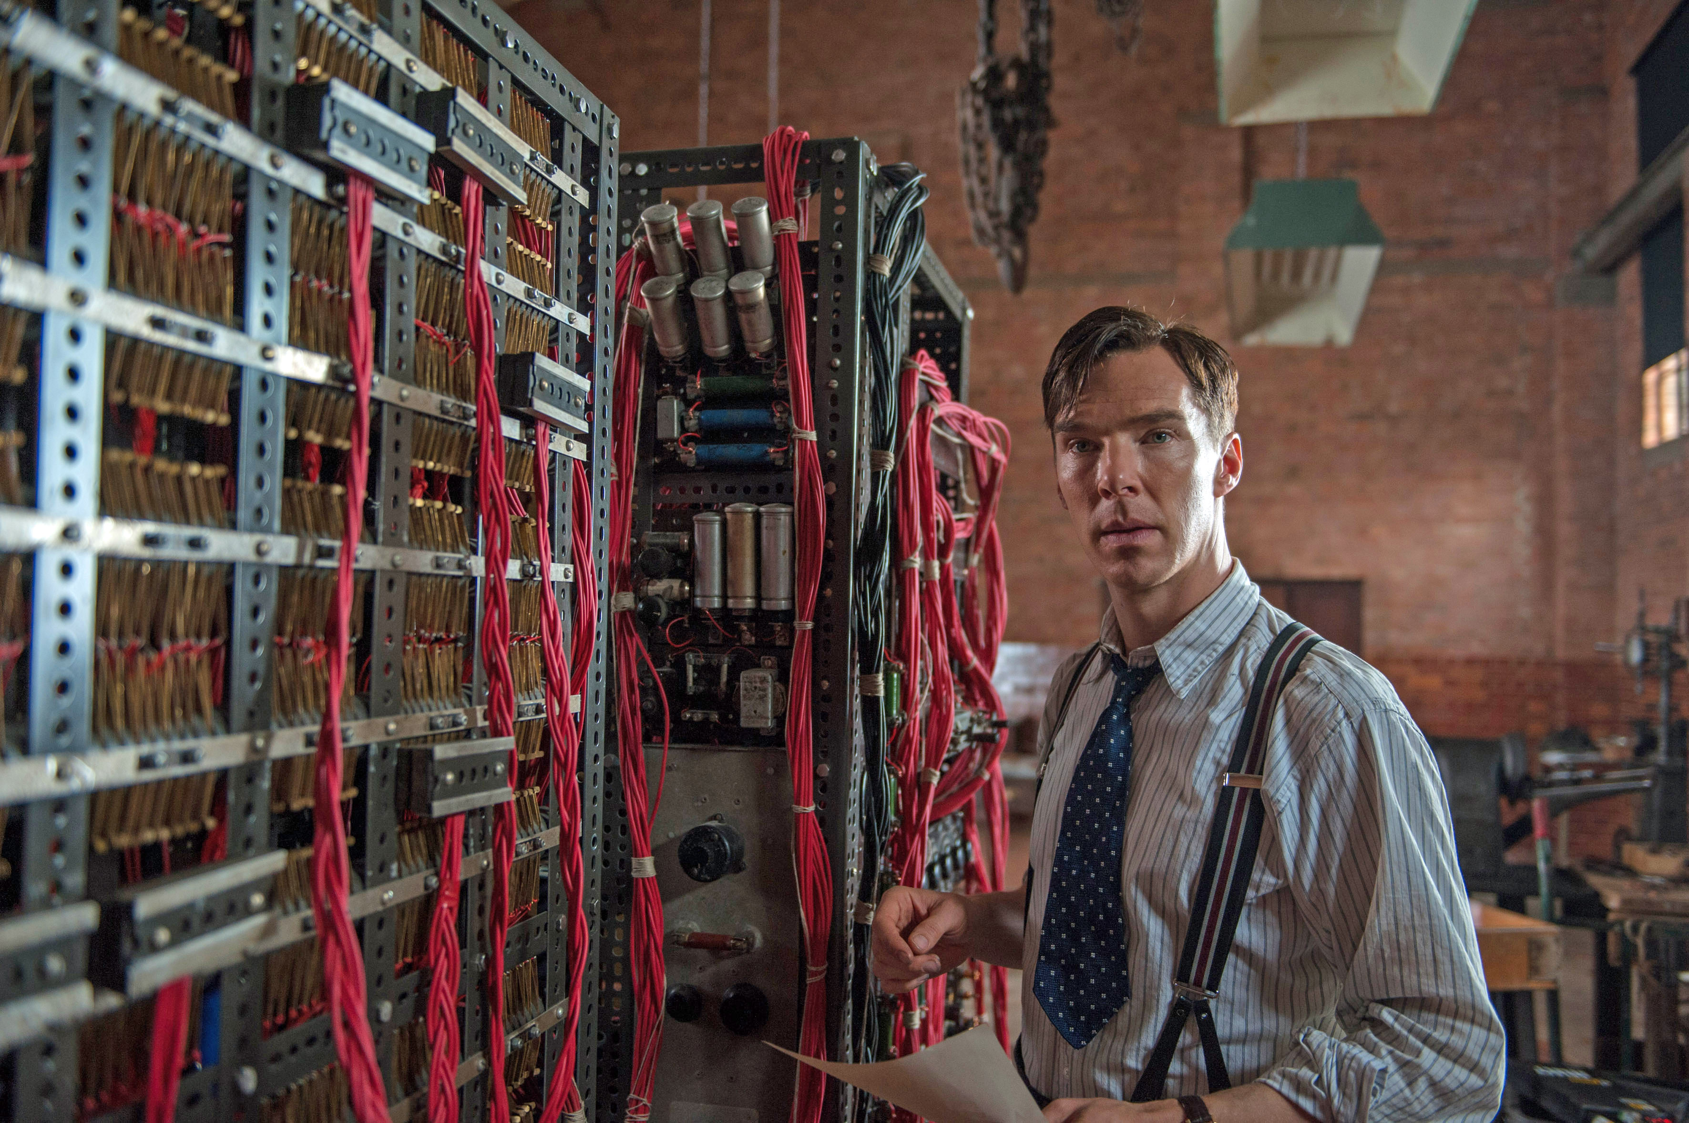
A cryptocurrency is based on digital cryptography
What is Bitcoin?
Derives trust from
NOT from legal tender statutes
NOT from chemical/physical properties
mathematical properties
based on established, trusted, cryptographic principles
cryptographic hashing
digital signatures
public key infrastructure

Slide 9
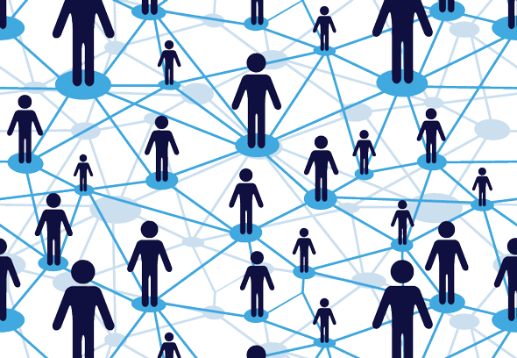
Bitcoin as a peer-to-peer network is …
What is Bitcoin?
decentralized
distributed
democratic
without the existence of a central authority

Slide 10
How does Bitcoin work?
What is Bitcoin?
Bitcoin | The protocol / technology
bitcoins | The currency / coin / unit of account
Transaction | Transfer of a coin from one owner to the next, signed cryptographically
Public/Private key | The receiver’s public key is his Bitcoin address The sender’s private key is used to digitally sign the transaction
Block | Validated collection of transactions over 10 minutes, created through mining
Mining | Generates a block and validates transactions through proof-of-work, creating new bitcoins in the process
Blockchain | Timestamped sequence of linked blocks The public ledger

Slide 11
What does a bitcoin look like?
What is Bitcoin?

Slide 12
Properties of Bitcoin
What is Bitcoin?
Decentralized
Distributed
Democratic
Anonymous
Fast, cheap, and irreversible
Secure
No double spending

Slide 13
What is Bitcoin?
System Architecture
Opportunities
Challenges
Closing
Q&A

Slide 14
"Good architecture meets the goals of the system”
System Architecture
Prof. Ed Crawley
Source: Prof. Ed Crawley, ESD.34, MIT

Slide 15
A new electronic cash system for online payments
System Architecture
Source: S. Nakamoto, “Bitcoin P2P e-cash paper,” Cryptography Mailing List. 01-Nov-2008.

Slide 16
The current payment system consists of three stakeholder groups
System Architecture
Beneficiaries
Primary Beneficiaries
Needs & Goals
Payers
Payees
Secure
Irreversible
Fast
Cheap
Easy to use
Direct
Anonymous
Stakeholders
Beneficial Stakeholders
Banks
Credit Card Companies
Money Transmitters
EPI Providers
Clearing Houses
Payment Processors
Needs & Goals
High Leverage Stakeholders
Prevent Criminal Activities
Consumer Protection
Monetary Policy
Policymakers
Regulators
Central Banks
The needs and goals of the primary beneficiaries and high leverage stakeholders should drive the architecture.

Slide 17
Based on the needs and goals we can formulate a system problem statement to synthesize the system
System Architecture
System Problem Statement (SPS): “To provide willing parties a means:
to transact directly with each other without the need for a trusted third party,
by transferring a unique piece of digital property,
using an electronic payment system based on cryptographic proof instead of trust.“
While also (descriptive goals):
Being secure (no theft, fraud or double spending)
Ensuring transactions are valid and irreversible
Being fast, cheap and easy to use
Providing anonymity to the parties involved
Complying with pertinent regulation
Allowing monetary policy
The SPS gives us a means to measure the quality of the architecture.

Slide 18
How does Bitcoin compare to the current payment system?
System Architecture
Goals | Bitcoin | Current system
Direct | ✓ | ✖
Anonymity | ✓ | ✖
Fast, cheap, and irreversible | ✓ | ✖
Security | ✓ | (✓)
No double spending | ✓ | ✓
Easy to use | ✖ | ✓
Compliance | ✖ | ✓
Monetary Policy | ✖ | ✓
Bitcoin currently fulfills many of the needs of the primary beneficiaries in the payment system. However, it does not fulfill the needs of the high leverage stakeholders.

Slide 19
Bitcoin was designed with two stakeholder groups in mind
System Architecture
Beneficiaries
Primary Beneficiaries
Payers
Payees
Stakeholders
Beneficiary Stakeholders
Bitcoin
High Leverage Stakeholders
Bitcoin ignores all of the high leverage stakeholders and replaces the beneficiary stakeholders with new ones.

Slide 20

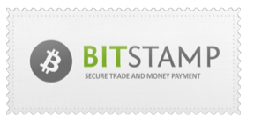
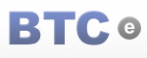


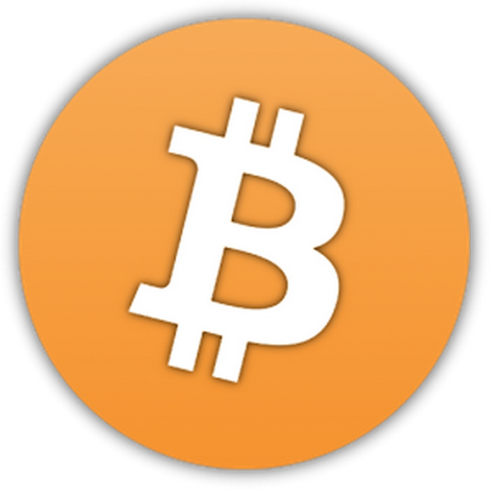






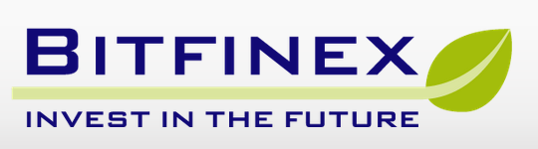


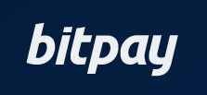

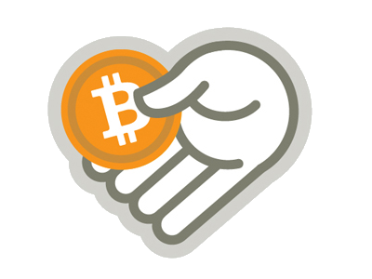














The Bitcoin Startup Ecosystem: Six Different Bitcoin Company Categories
System Architecture
Wallets
Exchanges
Universal
Payment Processing
Financial Services
Mining
Source: State of Bitcoin 2015, Coindesk

Slide 21
Bitcoin has the potential to revolutionize the payment industry
System Architecture
Goals | Bitcoin today | Current system | Bitcoin tomorrow
Direct | ✓ | ✖ | ✓
Anonymity | ✓ | ✖ | (✓)
Fast, cheap, and irreversible | ✓ | ✖ | ✓
Security | ✓ | (✓) | ✓
No double spending | ✓ | ✓ | ✓
Easy to use | ✖ | ✓ | ✓
Compliance | ✖ | ✓ | (✓)
Monetary Policy | ✖ | ✓ | ✖
If Bitcoin evolves to fulfill the needs of the high leverage stakeholders, it could replace the current payment system. However, there will be trade-offs between goals.

Slide 22
What is Bitcoin?
System Architecture
Opportunities
Challenges
Closing
Q&A

Slide 23
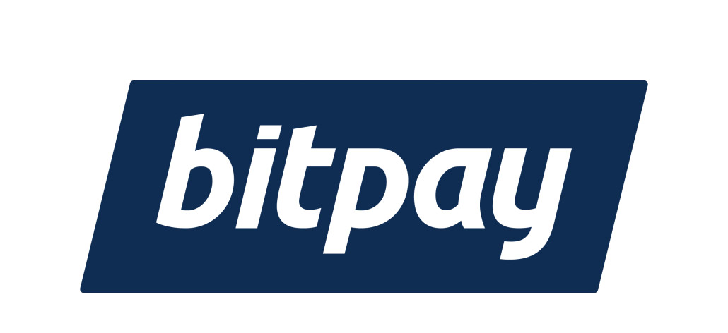

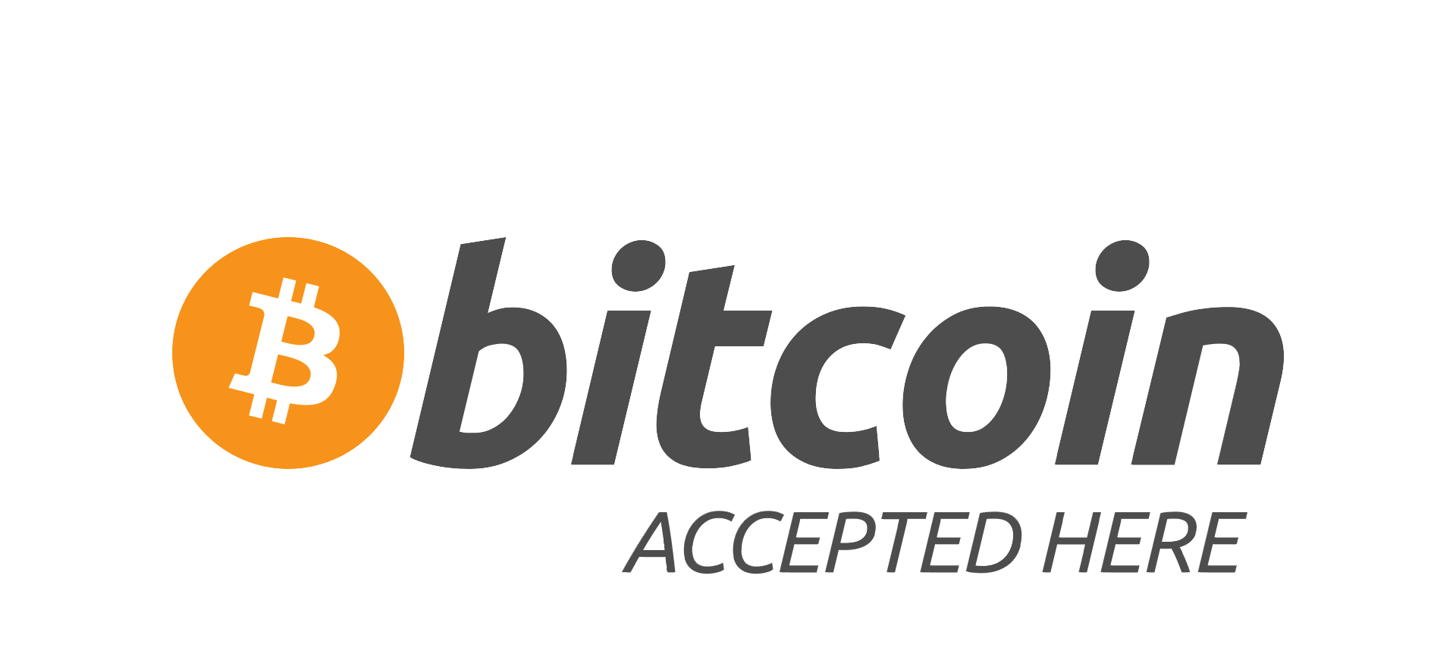

Money transfer and online payments
Opportunities
“There is no reason, in principle, why final settlements could not be carried out by the private sector without the need to be cleared through the central bank.”
Mervyn King, Governor of the Bank of England, 1999
Payments are cheaper, faster, and more secure with Bitcoin than with traditional payment systems, benefiting both sides of the transaction.

Slide 24

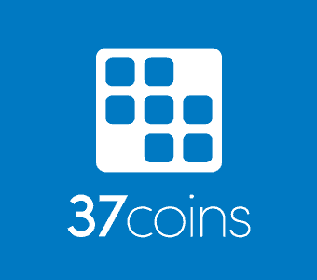

Potential to combat poverty and oppression
Opportunities
There are about 2.5 billion unbanked people in the world
Access to basic financial services is a promising antipoverty technique
M-Pesa is a mobile payment system using phones, not banks, in countries such as Kenya and Tanzania
Kipochi allows M-Pesa users to exchange bitcoins
Bitcoin can provide people in developing countries with inexpensive access to financial services on a global scale.

Slide 25
Micropayments
Opportunities
“The cost of mediation increases transaction costs, limiting the minimum practical transaction size and cutting off the possibility for small casual transactions.”
Pay per article instead of a subscription fee without pop-up ads
Pay for Wi-Fi by the second on the go
Pay milli-bitcoins per Email to avoid spam
Bitcoin allows the emergence of business models that were previously uneconomical
Source: S. Nakamoto, “Bitcoin P2P e-cash paper,” Cryptography Mailing List. 01-Nov-2008.

Slide 26
What is Bitcoin?
System Architecture
Opportunities
Challenges
Closing
Q&A

Slide 27
Challenges
Challenges
Adoption
Regulation
Criminal Use
Price Volatility

Slide 28
Regulatory frameworks around the world vary widely
Challenges

Slide 29
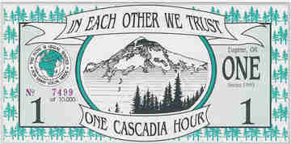



Regulation in the U.S.
Challenges
Private currency
Money transmission laws Consumer protection: NYDFS BitLicense
AML and Terrorism Financing FinCEN
CFTC Commodity and currency derivatives
Regulation is both, a risk for the diffusion of Bitcoin if too heavy handed, and a boon if done right.

Slide 30
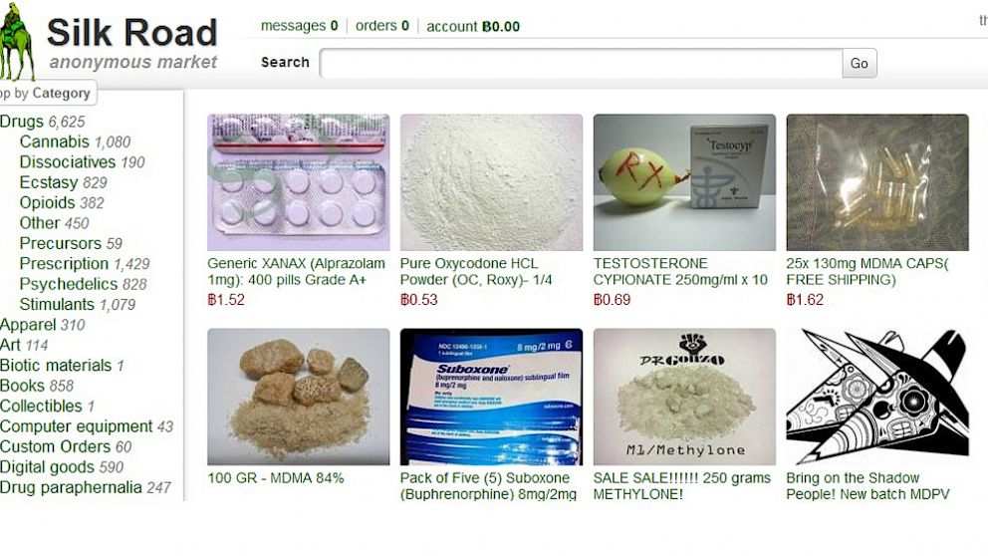
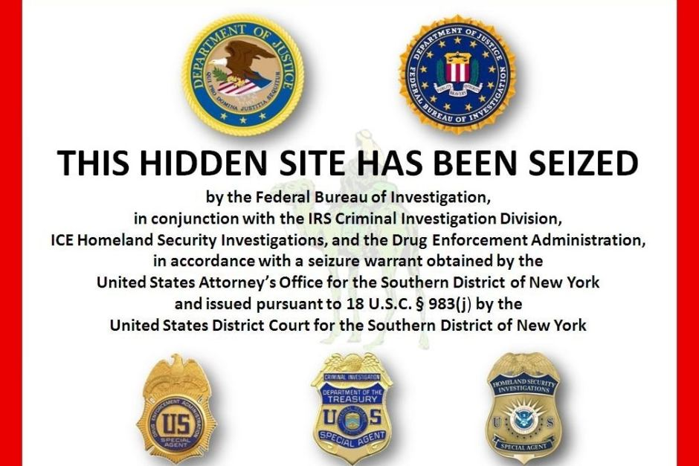
The Silk Road case
Challenges
Silk Road had an estimated $200 million in sales. 95% of which for drugs.
In October 2013 Silk Road was shut down
Silk Road was illegal, but so is dealing drugs in the physical world for dollars.

Slide 31
The Mt. Gox case
Challenges
Mt.Gox was the worst scandal in Bitcoin history and precipitated the burst of the bubble in early 2014. An estimated $500 million in bitcoins were lost.

Slide 32
Price History – All Time
Challenges
Source: blockchain.info (March 4, 2015)

Slide 33
Price History – 2 Years
Challenges
Source: blockchain.info (March 4, 2015)

Slide 34
The price of a bitcoin has fluctuated wildly in the past
Challenges
Extreme volatility deters the mainstream from holding bitcoins as a store of value
And makes it unsuitable as a unit of account
Merchants instantly exchange bitcoins for fiat
But volatility will subside as
speculators leave the system
market capitalization rises
shorts become available
concentration decreases and liquidity increases

Slide 35
What is Bitcoin?
System Architecture
Opportunities
Challenges
Closing
Q&A

Slide 36
Closing
“The digital currency known as Bitcoin is only six years old ... It is, quite simply, one of the most powerful innovations in finance in 500 years.”
P. Vigna, M. Casey: The Age of Cryptocurrency, 2015

Slide 37
Q&A
?

Slide 38
Bitcoin resources
http://bitcoin.org
http://en.wikipedia.org/wiki/Bitcoin
http://blockchain.info
http://www.coindesk.com
http://two-bit-idiot.tumblr.com
http://www.reddit.com/r/Bitcoin/
Video “How Bitcoin works under the hood”: https://www.youtube.com/watch?v=Lx9zgZCMqXE
P. Vigna, M. Casey: The Age of Cryptocurrency, 2015
http://mitbitcoinexpo.org

Slide 39
Contact details
Sascha Boehme
saschafb@gmail.com
www.linkedin.com/in/saschaboehme
17nVzYtumxBAyd6ycUv9Xu46GySxUTHwzp

